Slide 1

Announcements
This Friday
Project 1 due
Talk by Jeniya Tabassum
TweeTIME: A Minimally Supervised Method for Recognizing and Normalizing Time Expressions in Twitter

Slide 2

Recap: Search
Search problem:
States (configurations of the world)
Actions and costs
Successor function (world dynamics)
Start state and goal test
Search tree:
Nodes: represent plans for reaching states
Plans have costs (sum of action costs)
Search algorithm:
Systematically builds a search tree
Chooses an ordering of the fringe (unexplored nodes)
Optimal: finds least-cost plans

Slide 3
Uniform Cost Search
Strategy: expand lowest path cost
The good: UCS is complete and optimal!
The bad:
Explores options in every “direction”
No information about goal location
c ≤ 1
…
c ≤ 2
c ≤ 3
Start
Goal
[Demo: contours UCS empty (L3D1)]
[Demo: contours UCS pacman small maze (L3D3)]

Slide 4

Video of Demo Contours UCS Pacman Small Maze

Slide 5

Informed Search

Slide 6



Search Heuristics
A heuristic is:
A function that estimates how close a state is to a goal
Designed for a particular search problem
Examples: Manhattan distance, Euclidean distance for pathing
10
5
11.2

Slide 7
Example: Heuristic Function
h(x)

Slide 8
Example: Heuristic Function
Heuristic: the number of the largest pancake that is still out of place
3
h(x)
4
3
4
3
0
4
4
3
4
4
2
3
Notes:
A* expanded 8100 ; Path cost = 33
UCS expanded 25263 . Path cost = 33
Greedy expanded 10 . Path cost = 41
[0, 7, 5, 3, 2, 1, 4, 6]
(7, 0, 5, 3, 2, 1, 4, 6)
(6, 4, 1, 2, 3, 5, 0, 7)
(3, 2, 1, 4, 6, 5, 0, 7)
(1, 2, 3, 4, 6, 5, 0, 7)
(5, 6, 4, 3, 2, 1, 0, 7)
(6, 5, 4, 3, 2, 1, 0, 7)
(0, 1, 2, 3, 4, 5, 6, 7)

Slide 9
Greedy Search
b
Strategy: expand a node that you think is closest to a goal state
Heuristic: estimate of distance to nearest goal for each state
A common case:
Best-first takes you straight to the (wrong) goal
Worst-case: like a badly-guided DFS
…
b
…
[Demo: contours greedy empty (L3D1)]
[Demo: contours greedy pacman small maze (L3D4)]
Notes:
For any search problem, you know the goal. Now, you have an idea of how far away you are from the goal.

Slide 10
Video of Demo Contours Greedy (Empty)

Slide 11
Video of Demo Contours Greedy (Pacman Small Maze)

Slide 12
A*: Combining UCS and Greedy
Uniform-cost orders by path cost, or backward cost g(n)
Greedy orders by goal proximity, or forward cost h(n)
A* Search orders by the sum: f(n) = g(n) + h(n)
8
g = 0 h=6
S
e
h=1
g = 1 h=5
a
1
1
3
2
g = 2 h=6
g = 9 h=1
S
a
d
G
b
d
g = 4 h=2
e
h=6
1
h=5
h=2
h=0
1
g = 3 h=7
g = 6 h=0
g = 10 h=2
c
b
c
G
d
h=7
h=6
g = 12 h=0
G
Example: Teg Grenager

Slide 13


Admissible Heuristics
A heuristic h is admissible (optimistic) if:
where is the true cost to a nearest goal
Examples:
Coming up with admissible heuristics is most of what’s involved in using A* in practice.
4
15

Slide 14




Optimality of A* Tree Search: Blocking
Proof:
Imagine B is on the fringe
Some ancestor n of A is on the fringe, too (maybe A!)
Claim: n will be expanded before B
f(n) is less or equal to f(A)
f(A) is less than f(B)
n expands before B
All ancestors of A expand before B
A expands before B
A* search is optimal
…

Slide 15
Properties of A*
Uniform-Cost
A*
b
b
…
…

Slide 16
UCS vs A* Contours
Uniform-cost expands equally in all “directions”
A* expands mainly toward the goal, but does hedge its bets to ensure optimality
Start
Goal
Start
Goal
[Demo: contours UCS / greedy / A* empty (L3D1)]
[Demo: contours A* pacman small maze (L3D5)]

Slide 17
Video of Demo Contours (Empty) -- UCS

Slide 18
Video of Demo Contours (Empty) -- Greedy

Slide 19
Video of Demo Contours (Empty) – A*

Slide 20
Video of Demo Contours (Pacman Small Maze) – A*

Slide 21



Comparison
Greedy
Uniform Cost
A*

Slide 22
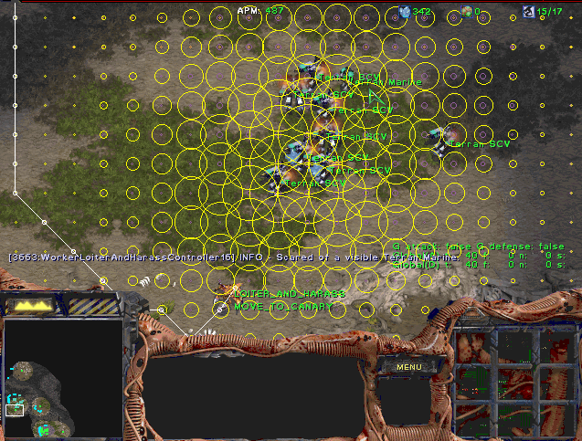
A* Applications
Video games
Pathing / routing problems
Resource planning problems
Robot motion planning
Language analysis
Machine translation
Speech recognition
…
[Demo: UCS / A* pacman tiny maze (L3D6,L3D7)]
[Demo: guess algorithm Empty Shallow/Deep (L3D8)]

Slide 23
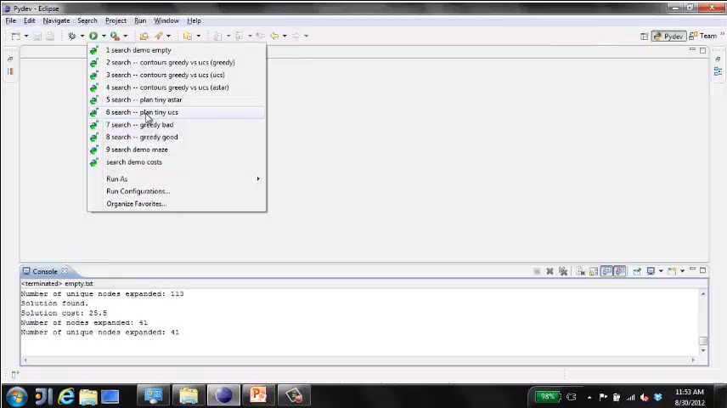
Video of Demo Pacman (Tiny Maze) – UCS / A*

Slide 24

Creating Heuristics

Slide 25
Creating Admissible Heuristics
Most of the work in solving hard search problems optimally is in coming up with admissible heuristics
Often, admissible heuristics are solutions to relaxed problems, where new actions are available
Inadmissible heuristics are often useful too
366
15

Slide 26
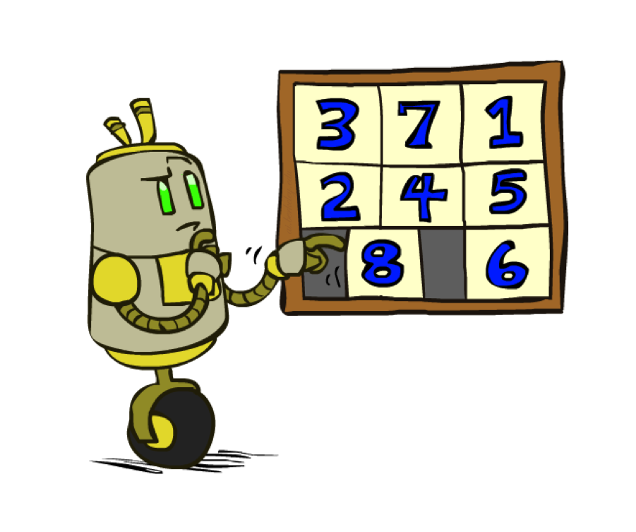
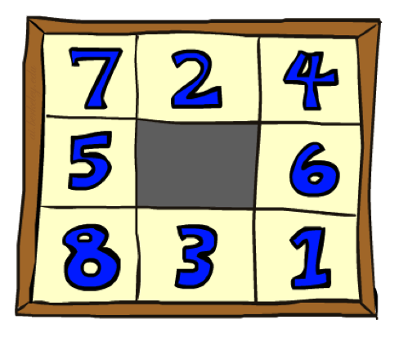
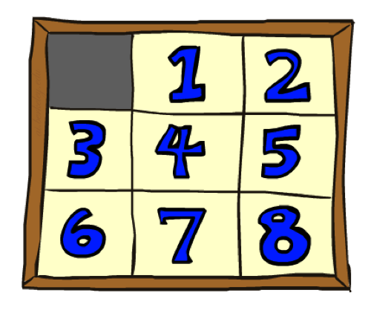
Example: 8 Puzzle
Start State
Actions
Goal State
What are the states?
How many states?
What are the actions?
How many successors from the start state?
What should the costs be?

Slide 27
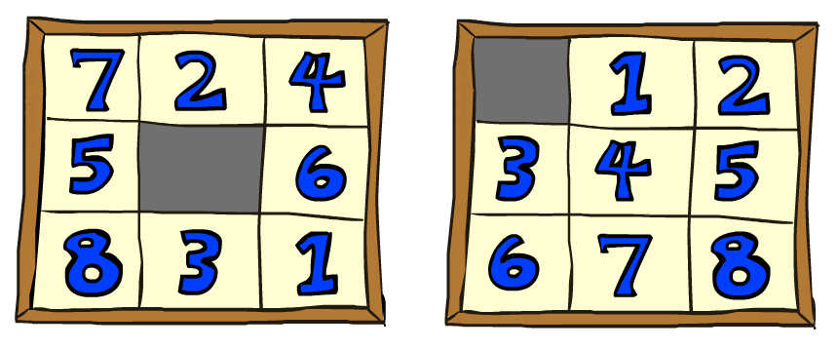
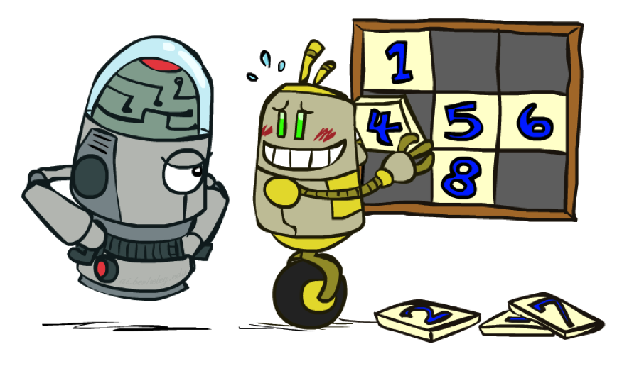
8 Puzzle I
Heuristic: Number of tiles misplaced
Why is it admissible?
h(start) =
This is a relaxed-problem heuristic
8
Start State
Goal State
 | Average nodes expanded when the optimal path has…
 | …4 steps | …8 steps | …12 steps
UCS | 112 | 6,300 | 3.6 x 10⁶
TILES | 13 | 39 | 227
Statistics from Andrew Moore

Slide 28
8 Puzzle II
What if we had an easier 8-puzzle where any tile could slide any direction at any time, ignoring other tiles?
Total Manhattan distance
Why is it admissible?
h(start) =
Start State
Goal State
 | Average nodes expanded when the optimal path has…
 | …4 steps | …8 steps | …12 steps
TILES | 13 | 39 | 227
MANHATTAN | 12 | 25 | 73
3 + 1 + 2 + … = 18

Slide 29
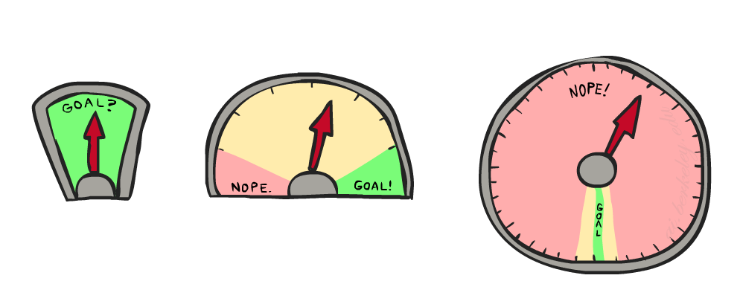
8 Puzzle III
How about using the actual cost as a heuristic?
Would it be admissible?
Would we save on nodes expanded?
What’s wrong with it?
With A*: a trade-off between quality of estimate and work per node
As heuristics get closer to the true cost, you will expand fewer nodes but usually do more work per node to compute the heuristic itself

Slide 30
Consistency of Heuristics
Main idea: estimated heuristic costs ≤ actual costs
Admissibility: heuristic cost ≤ actual cost to goal
h(A) ≤ actual cost from A to G
Consistency: heuristic “arc” cost ≤ actual cost for each arc
h(A) – h(C) ≤ cost(A to C)
Consequences of consistency:
The f value along a path never decreases
h(A) ≤ cost(A to C) + h(C)
A* graph search is optimal
A
1
C
h=4
h=1
h=2
3
G

Slide 31
Optimality of A* Graph Search
Sketch: consider what A* does with a consistent heuristic:
Fact 1: In tree search, A* expands nodes in increasing total f value (f-contours)
Fact 2: For every state s, nodes that reach s optimally are expanded before nodes that reach s suboptimally
Result: A* graph search is optimal
…
f ≤ 1
f ≤ 2
f ≤ 3

Slide 32

Optimality
Tree search:
A* is optimal if heuristic is admissible
UCS is a special case (h = 0)
Graph search:
A* optimal if heuristic is consistent
UCS optimal (h = 0 is consistent)
Consistency implies admissibility
In general, most natural admissible heuristics tend to be consistent, especially if from relaxed problems

